Slide 1




Stormwater
Pollution
August 2014
Notes:
This presentation is an introductory level presentation intended for general audiences and particularly kids with parents. It is intended to be fun and informative with numerous animations and pictures. Some base level audience understanding of stormwater runoff is beneficial (Ex. Companion slideshow entitled “Stormwater Runoff 101” which would be viewed first. Presentation time is 10-20 minutes depending on questions and audience involvement.

Slide 2


Brought To You By:
& This Guy!
Maxwell Schwartz
This Guy!
Charley Schwartz, PE
Senior Environmental Engineer
Leon County Development Support & Environmental Management
Renaissance Center, 2nd Floor
435 North Macomb Street
Tallahassee, FL 32301
Phone: (850)606-1381
Email: schwartzc@leoncountyfl.gov

Slide 3
Common Pollutants
Sediment
Nutrients
Dissolved Oxygen (Algae)
Bacteria (Fecal Coliforms)
Oil & Grease/ Metals
Temperature
Atmospheric Deposition
Floatables (Litter)
Notes:
Overview of pollutants to be discussed.

Slide 4
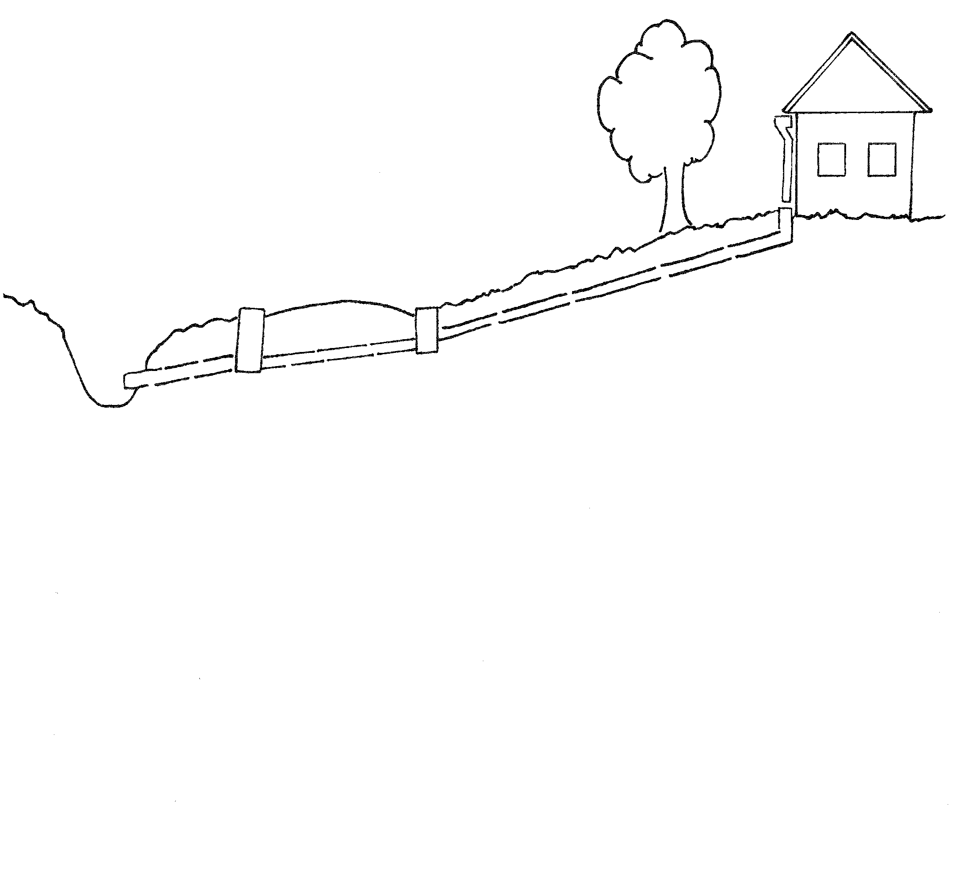
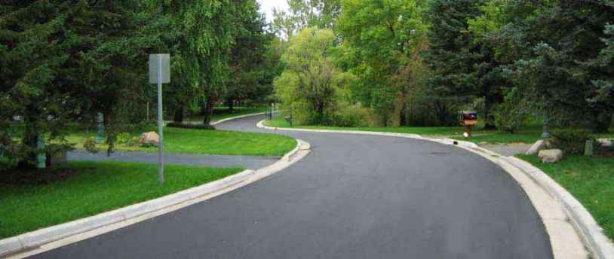

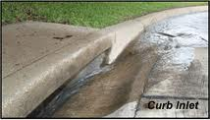
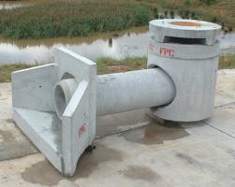
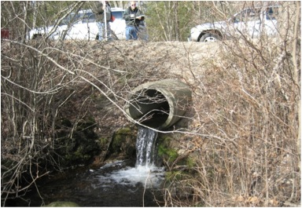
Stormwater Runoff
Notes:
Describe the sample residential lot & road drainage cross section used in the presentation.

Slide 5





Sediment
Notes:
Introduce our nefarious lumberjack trouble maker, who proceeds to DESTABILIZE the site by removing trees …

Slide 6
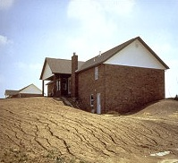
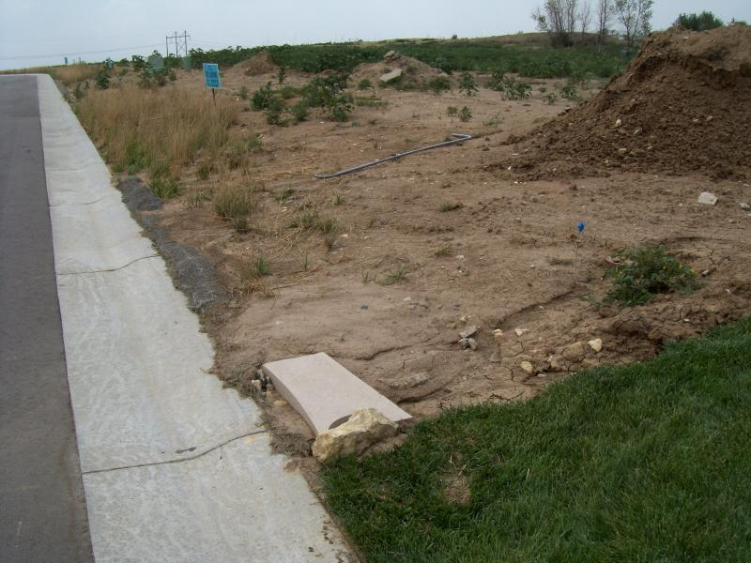
Sediment
Notes:
… & grass/groundcover which exposes raw soil/dirt.

Slide 7
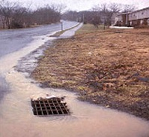
Sediment
Notes:
Rainfall washes unstabilized dirt into the drainage system and into streams, lakes & waterbodies. Arrow changes color as it picks up more and more dirt as it drains across the yard.

Slide 8
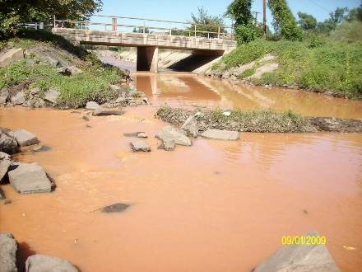
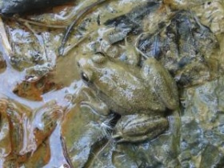
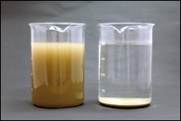

Sediment
Discolor
Smother
Shade
Sponge
Notes:
Sediment is one of the primary water pollutants. Apart from discoloring water, it can suffocate aquatic wildlife by clogging gills, covering skin pores on amphibians and burying eggs and small fry. Sediment also clouds water making it difficult for fish to see and reducing sunlight to underwater plants. Sediment acts like a sponge and serves as a surface for other pollutants to stick and for harmful bacteria to grow.

Slide 9




Nutrients
Notes:
Our mean old lumberjack is applying fertilizer irresponsibly to his yard. Fertilizers contain high levels of nutrients including Phosphorous and Nitrogen which can cause problems at high concentrations in water. Excess fertilizer in yards and on streets, sidewalks and driveways are washed into the drainage system and into streams during storms.

Slide 10
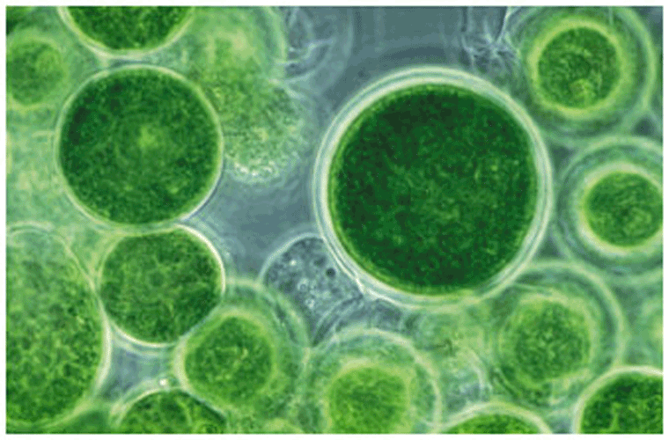
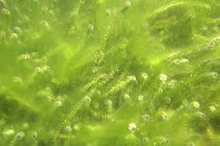
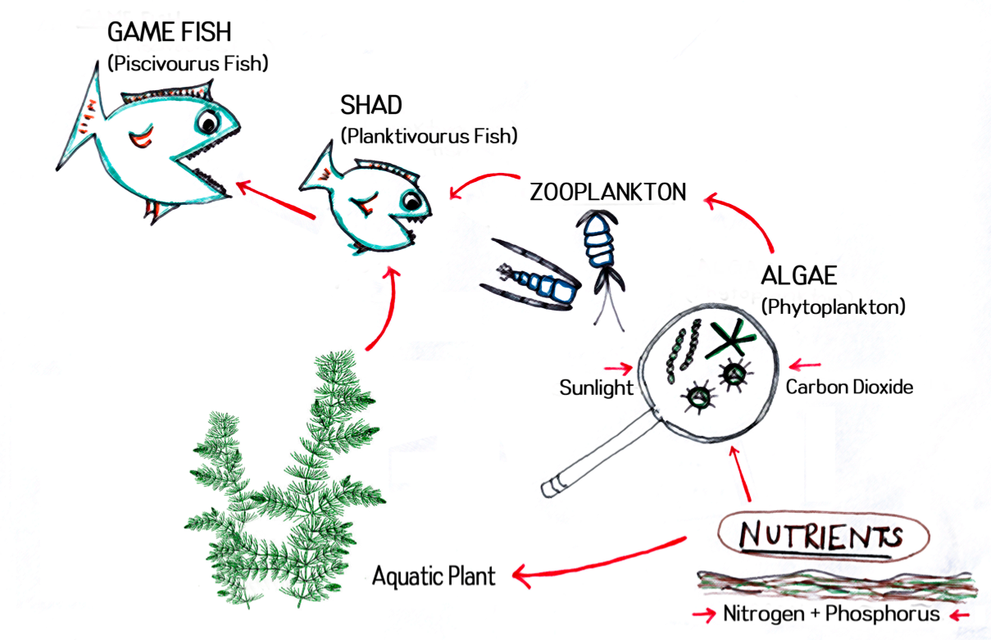
Dissolved Oxygen (Algae)
Food Web
Nutrients =
Plant Food
www.pkgills.com
Notes:
Nutrients are a critical part of a healthy food web, providing food to plants at the base of the food chain… however, too much nutrients can cause problems…

Slide 11
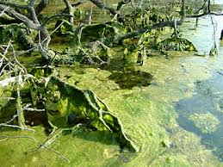
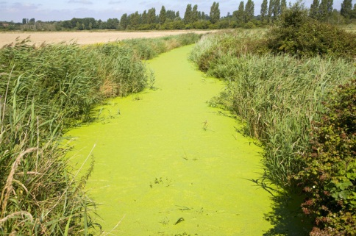
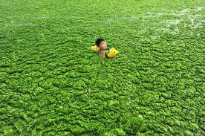
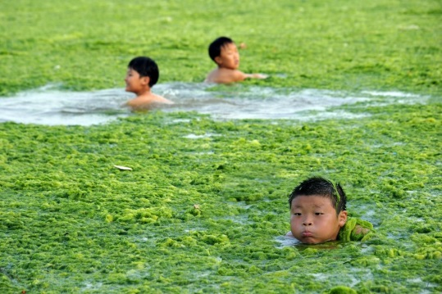
Dissolved Oxygen (Algae)
Algae Bloom
Notes:
…such as algae blooms. Algae blooms can clog the surface of waterbodies …

Slide 12


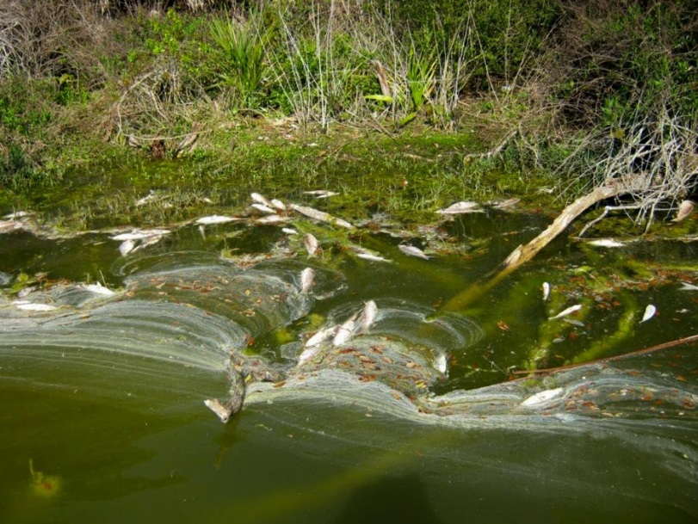

Dissolved Oxygen (Algae)
O₂
Day
Night
O₂
Hypoxia
Notes:
Too much algae also can result in low dissolved oxygen levels in water (Hypoxia) and result in fish kills. While algae and plants produce oxygen during the day, they consume oxygen at night. Waters that contain lots of algae can have early morning fish kills resulting from the reduced oxygen from algae respiration as well as decomposition of dead algae which also consumes oxygen.

Slide 13








Bacteria (Fecal Coliforms)
Notes:
Animals do what animals do & they don’t have toilets that go to wastewater treatment plants. Too much animal waste in one place can lead to nasty bacteria in nearby streams. Be mindful to pick up after pets near waterbodies and storm drains.

Slide 14


Oil/Grease/Metals
Oil/Grease
Exhaust
Break Dust
Tire Rubber
Car Parts
Notes:
Oil Grease & metals are common pollutants often associated with routine operation of automobiles. While amount from a single car may be small … there are a LOT of cars on the roads these days.

Slide 15


Oil/Grease/Metals
Oil
Notes:
Our lumberjack is also not being responsible with the disposal of oil…

Slide 16
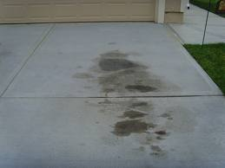
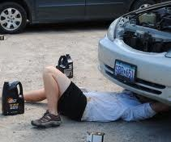
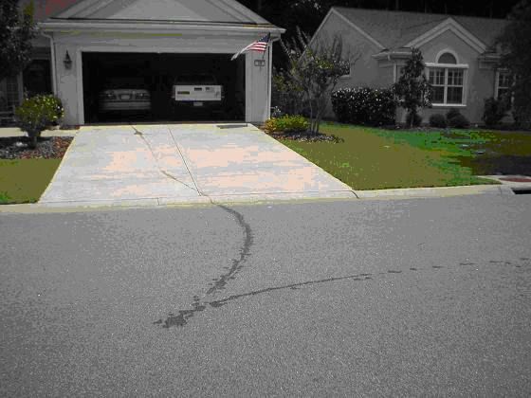
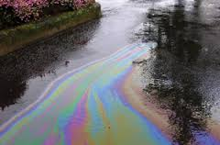
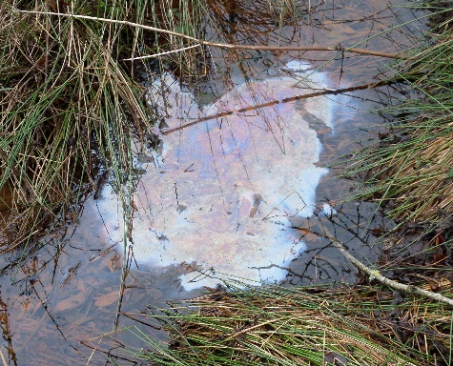
Oil/Grease/Metals
Iron Bacteria
Notes:
Photos of leaking oil. Oil can be observed with a rainbow sheen. Iron bacteria in water also can produce a rainbow sheen. If you poke the sheen with a stick or stone, iron bacteria will break apart while oil will quickly draw back together.

Slide 17



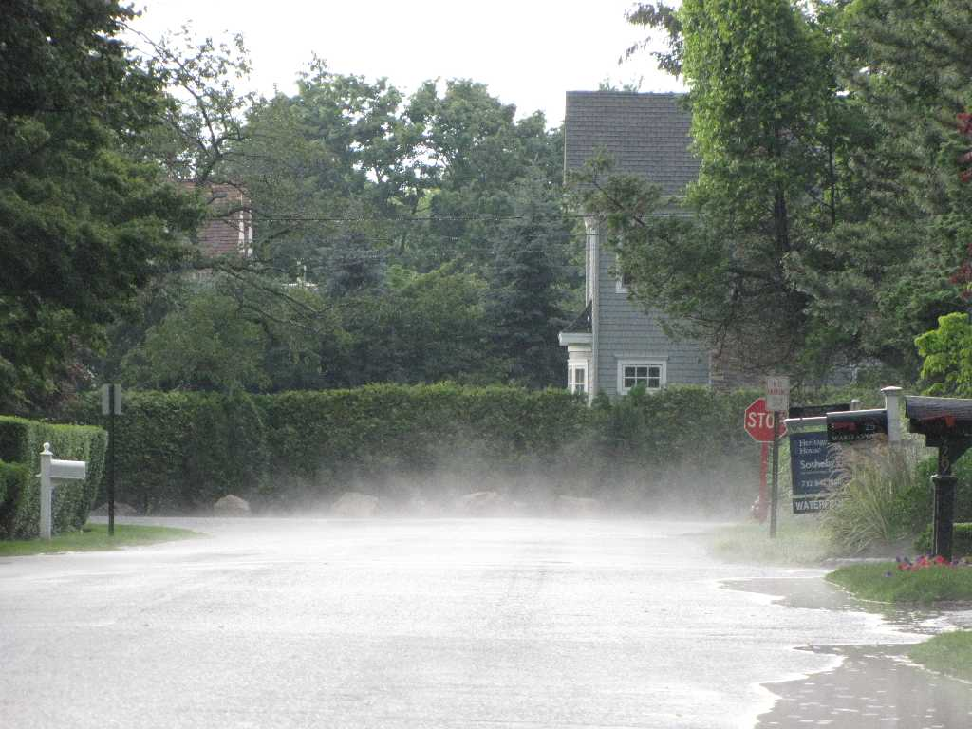
Temperature
Notes:
An often forgotten stormwater pollutant is the temperature of runoff. During the day road surfaces (especially dark roads) soak up heat from the sun. Afternoon rain storms can send very hot water into the drainage system. As a result small streams can have significant spikes in the stream temperature leading to stress or death of aquatic life.

Slide 18
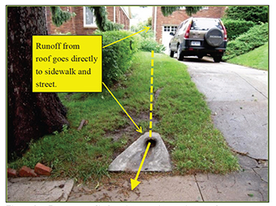
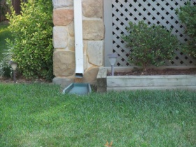
Temperature
Disconnect Downspouts ->
Notes:
Roofs also get very hot and can lead to similar stream impacts. Disconnecting roof runoff so that water can flow across cooler ground/grass greatly reduces the temperature of runoff.

Slide 19




Atmospheric Deposition
Notes:
What goes up comes back down. Rainfall itself can have some pollutants associated with cumulative exhaust/gas from industrial factories, car/plane exhaust, wildfires, toxic spills, etc. Fortunately with present day air quality treatment requirements at factories, on cars, etc., these levels of pollution are much lower than the past.

Slide 20
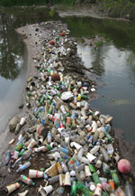
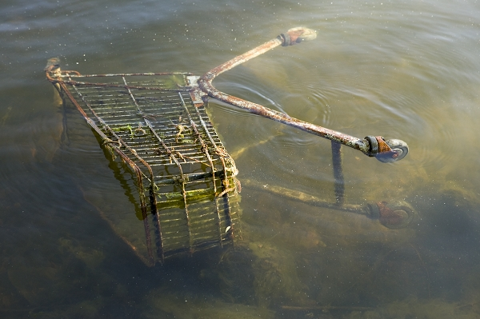
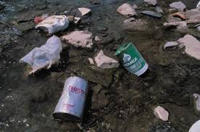
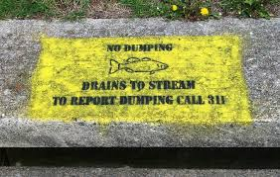
Floatables
… & Sinkables?
Notes:
Garbage thrown on the land often finds its way into streams. Thanks to public education campaigns and increased awareness, this pollutant source has been greatly reduced, but keep up the good work and spread the word.

Slide 21

SW Runoff 102
COMING SOON!
“REVENGE
OF THE
BMPS!”
Notes:
This upcoming presentation will focus on different types of stormwater BMPs.

