Slide 1


Stormwater
R
U
N
O
F
F
August 2014
Notes:
This presentation is an introductory level presentation intended for general audiences and particularly kids with parents. It is intended to be fun and informative with numerous animations and pictures. No base level audience understanding of stormwater runoff is necessary. Presentation time is 10-20 minutes depending on questions and audience involvement.

Slide 2

The Big Picture
Rain
Runoff
Notes:
Overview of main topics to be discussed.

Slide 3
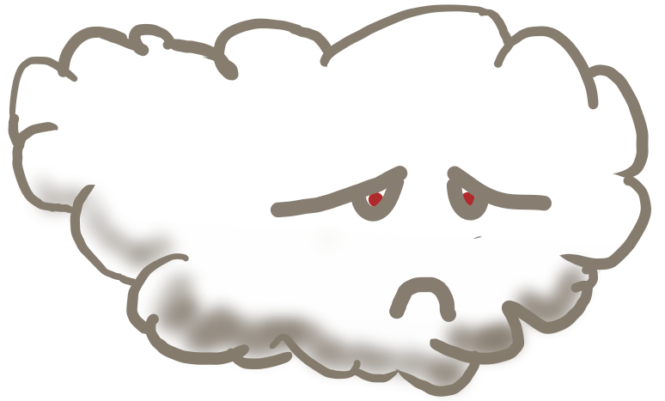




Rain
When It
Gets Big….
This Is A Cloud…
…It Cries
& It Is Made Of
Teeny
Tiny
Water
Drops
Its Tears Are
Called Rain

Slide 4


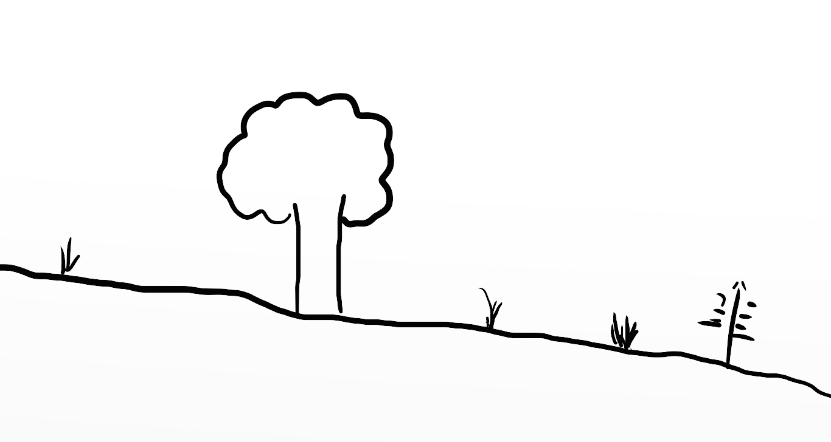
Runoff
This Is Land
When It Rains The Land Gets Wet…
…And Drinks The Water
When The Land Gets Very Wet
The Land Gets Full Of Water & Can’t Drink Anymore
The Extra Water Runs Off.

Slide 5
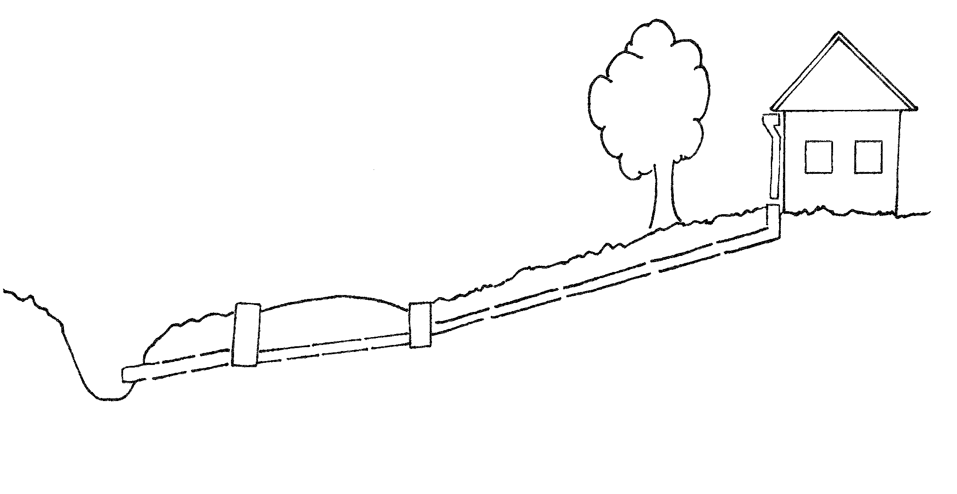
Stormwater Runoff
Notes:
This is a yard that drains to a street inlet, through pipes and then to a stream.

Slide 6

Key Terms
Infiltration
ET
Ponding
Soil Compaction
Notes:
Introduction to Runoff Terms

Slide 7

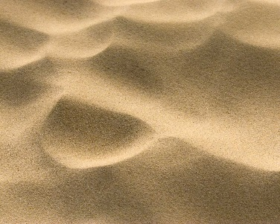
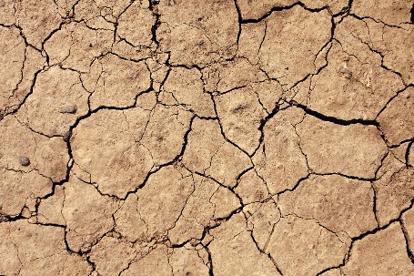

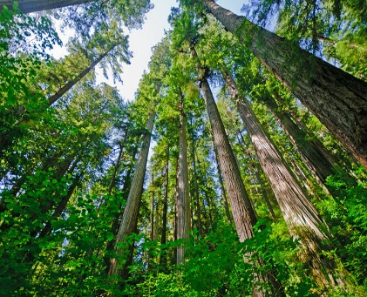

Infiltration
How Quickly Water Soaks Into The Ground
Function Of Soils…
Sand
Clay
Asphalt
Good
Bad
ForgetAboutIt
…And Ground Cover
Trees
Grass
Asphalt
Good
Ok
I Told You
ForgetAboutIt

Slide 8
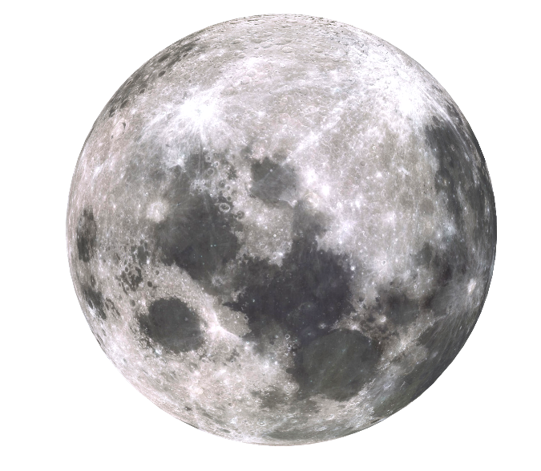


ET ?
Notes:
Fun to do a show of hands to see how many little people know who this guy is.

Slide 9
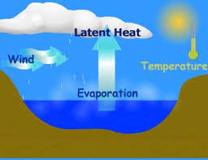
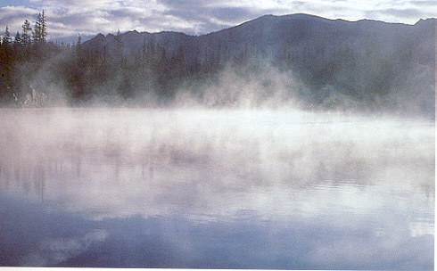
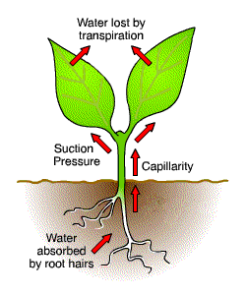
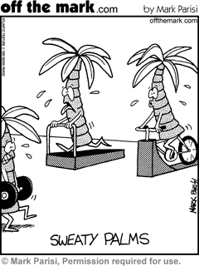
ET = Evapotranspiration
Evaporation
Transpiration
Notes:
Evaporation + Transpiration equals Evapotranspiration. Describe the two processes.

Slide 10
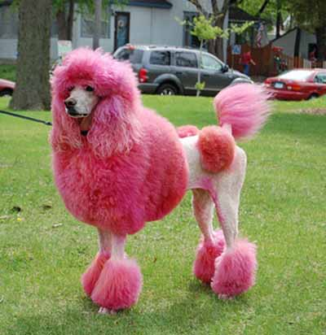
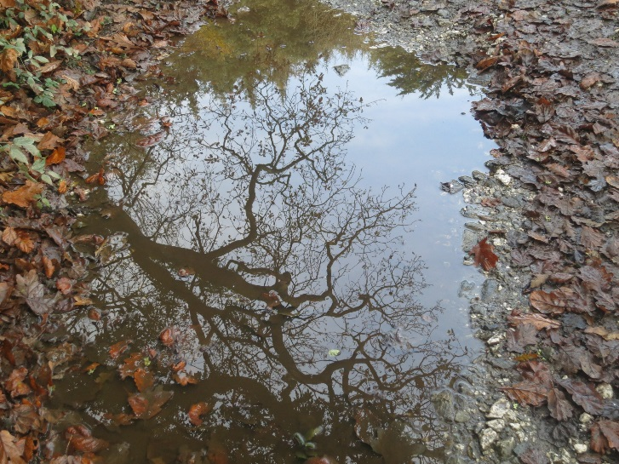
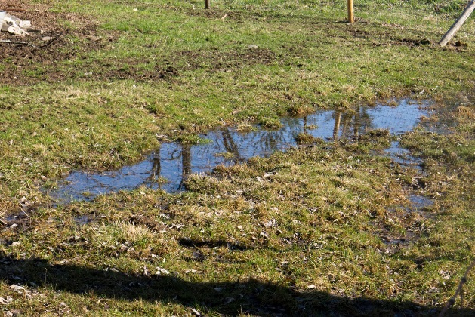
Ponding = Shallow Puddles
Not Poodles

Slide 11
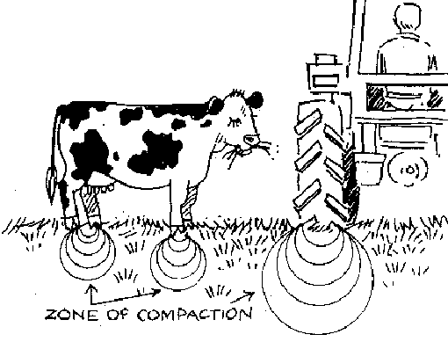
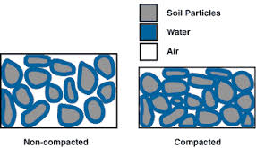
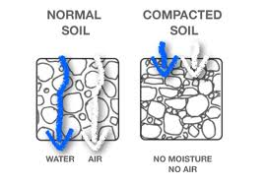
Soil Compaction
Density (Tightness) of Soil
Notes:
When heavy things contact the ground, they compact the dirt. Dirt near the surface and point of contact are compacted the most with soils deeper and farther away compacted less. Compacted areas are called the Zone of Compaction and are bigger for heavier objects. The more times a heavy load is applied to an area the more compact the soils become. Compacted soils have small spaces for air and water to move and therefore water & air movement is slowed down.

Slide 12


Sooo … Altogether Now

Slide 13
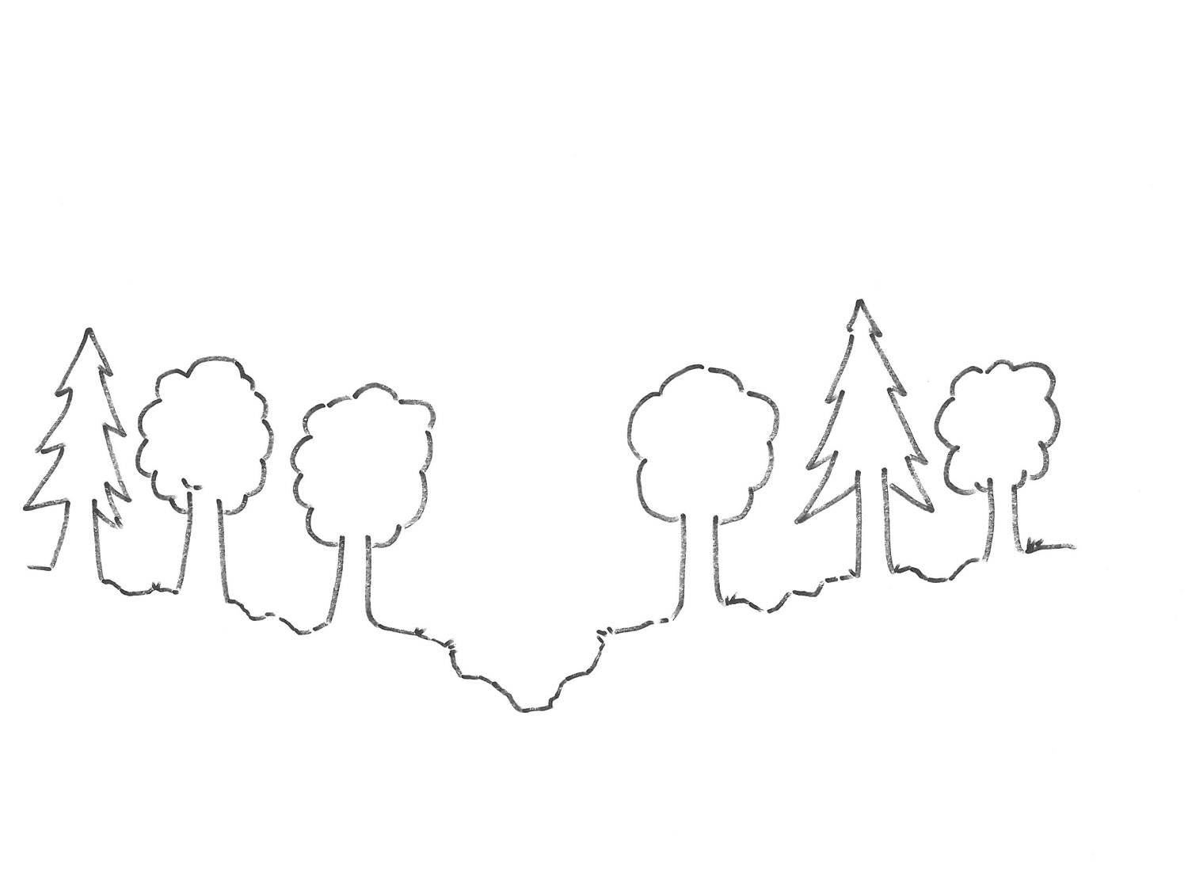


Ground Cover
Soil Type
Soil Compaction
Rainfall
Infiltration
Ponding
ET
Runoff
Notes:
This slide steps through all the different processes that reduce runoff. What is left is runoff. The line below the ground is a water table. Rainfall that soaks into the ground frequently reaches nearby storms looong after a rain event and help maintain Base Flow levels in streams.

Slide 14
Potential Runoff Effects
Quantity = Flooding
Quality = Pollution
Notes:
Overview of two main runoff issues.

Slide 15
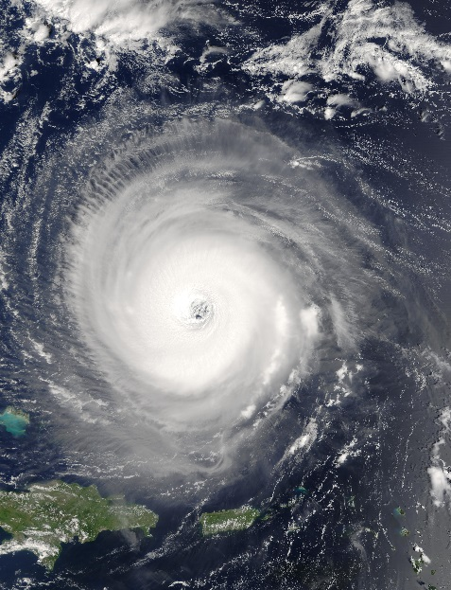
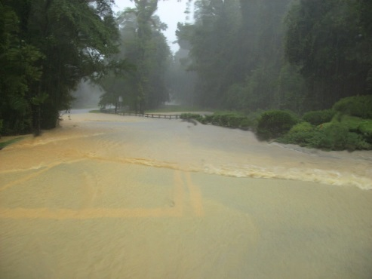
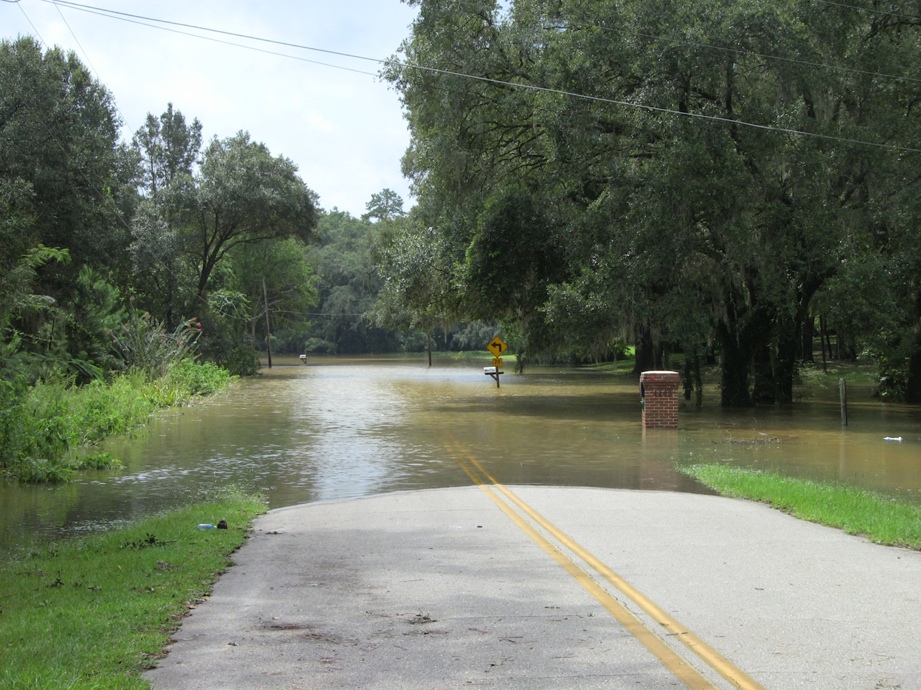
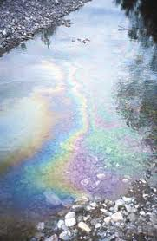
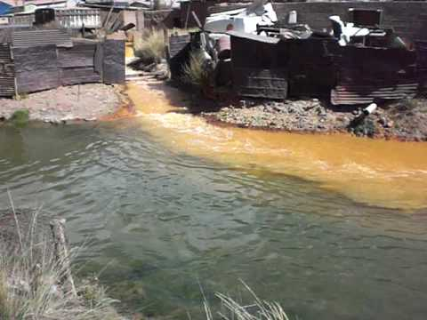
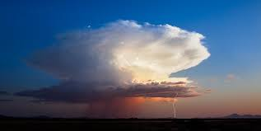
Quantity
Infrequent
Lots Of Water
Critical Storms
Volume V Rate
Quality
Flooding
Big Storm
Frequent
< 0.5” water
Pollution
Small Storms
Notes:
Too much water (quantity) can lead to flooding. Flooding is typical of big storms and can be a result of a short duration high intensity storm (strong afternoon thundershower) or a longer duration less intense storm (slow moving frontal system) or things in between. Water quality problems are most associated with very frequent but less intense storm events. Essentially events that flush/clean the surface of the land (first flush storms).

Slide 16





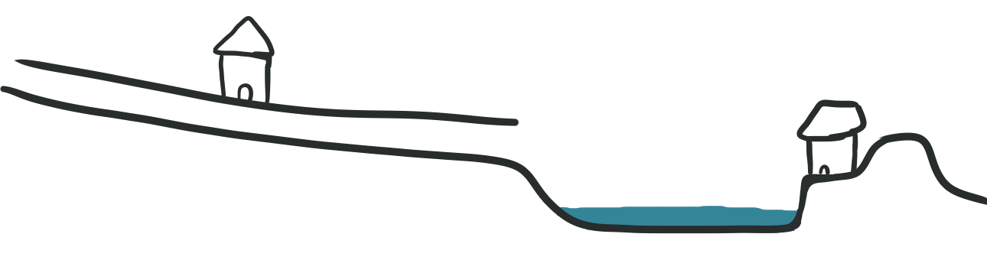
Flooding
Dendritic (Tree like)
Bowl
Rainfall
Intensity
& Duration
Rate
Volume
Rainfall Intensity
Top View
Lake
Stream
Top of
Channel Bank
Side View
Channel Bottom
Notes:
This slide shows a dendritic and bowl drainage condition. The top view and side view will be evaluated in the following slides. Streams and flooding are rate driven (high intensity short duration). Bowls are predominantly volume driven (they fill up).

Slide 17
Flooding
Frequent (Small Storm)
Notes:
Frequent small storms stay well within the banks of their channels & provide only produce a little volume.

Slide 18
Flooding
Infrequent (Big Storm)
Notes:
Larger less frequent storms are still typically within the banks or shelf of a stream and deliver more volume.

Slide 19
Flooding
Rare (Storm Giant)
Notes:
Big storms overflow stream banks and spill out into the floodplain and may produce large volumes of water that may fill and overtop lakes and isolated depressions. It is important to locate homes out of the floodplain and elevate them above estimated flood elevations.

Slide 20
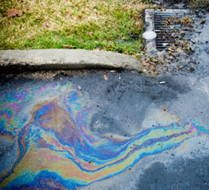
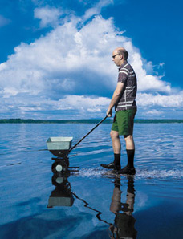


Water Quality
Sediment
Nutrients
    (Nitrogen,
    Phosphorus)
Pesticides
Bacteria
Oil & Grease
Metals
Temperature
Floatables
Notes:
Brief inventory of different types of pollutants. Companion powerpowint “Stormwater Pollutants 101” goes over these in greater detail.

Slide 21
